Slide 1
Data Warehousing Week # 02

Slide 2
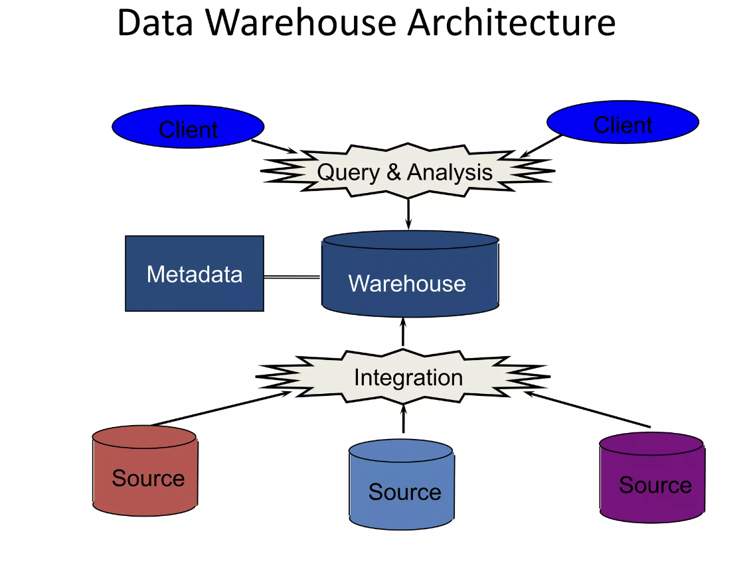

Slide 3
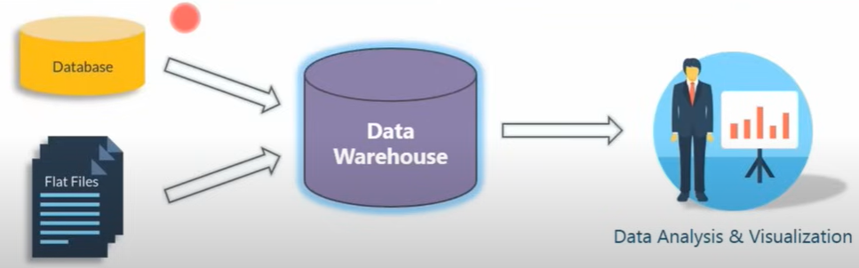
Data warehouse architecture

Slide 4
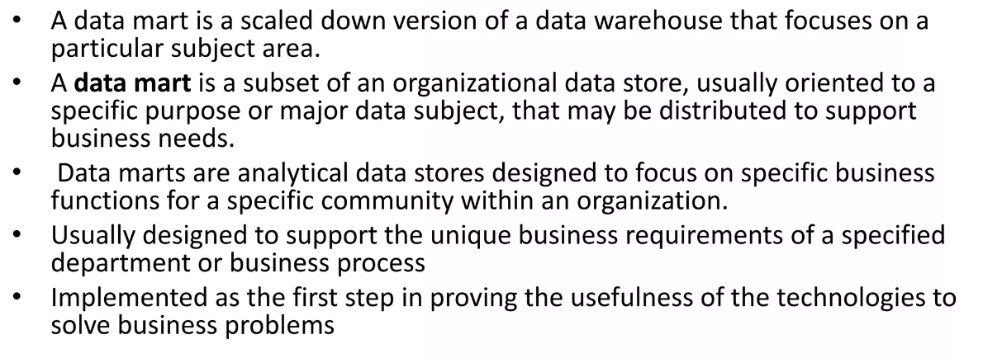
Data Mart

Slide 5
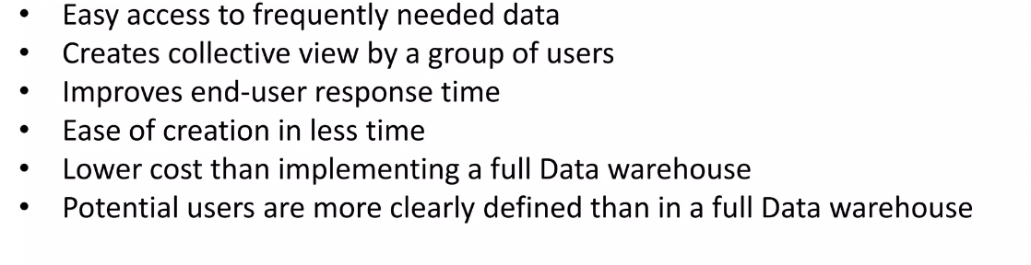
Reasons for creating Data Marts

Slide 6
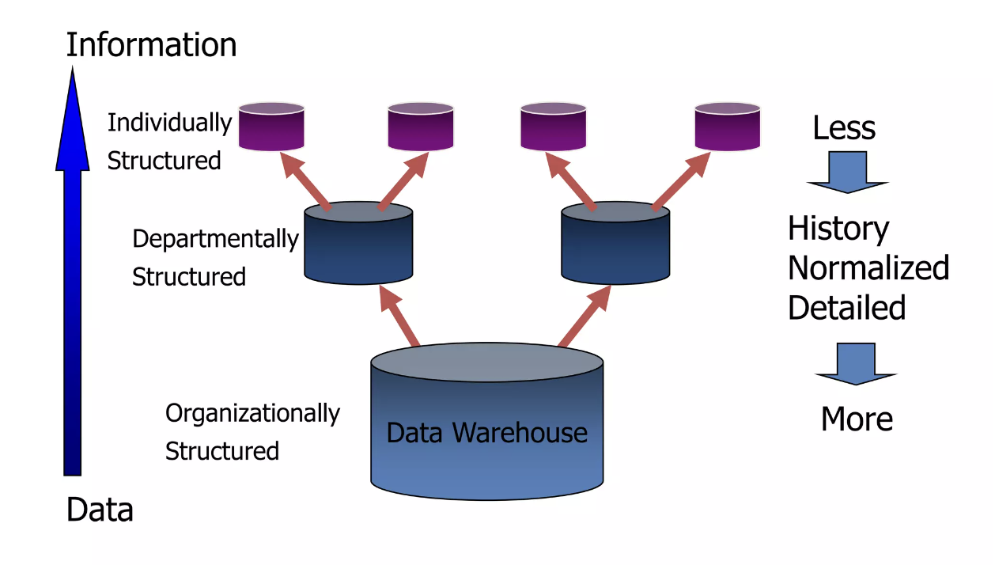
From Data warehouse to Data Marts

Slide 7
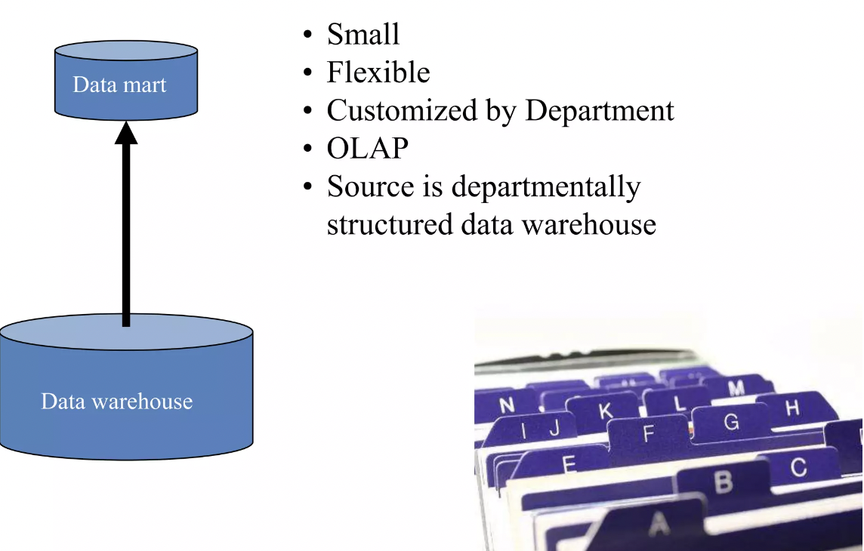
Characteristics of Departmental Data Mart

Slide 8
Elements of Dimensional Data Model
Fact
Dimension
Attributes
Fact Table
Dimension Table

Slide 9
Fact
Facts are the measurements/metrics or facts from your business process. For a Sales business process, a measurement would be quarterly sales number

Slide 10
Dimension
Dimension provides the context surrounding a business process event. In simple terms, they give who, what, where of a fact. In the Sales business process, for the fact quarterly sales number, dimensions would be
Who – Customer Names
Where – Location
What – Product Name

Slide 11
Facts & Dimensions
“Facts and dimensions are the fundamental elements that define a data warehouse. They record relevant events of a subject or functional area (facts) and the characteristics that define them (dimensions).”

Slide 12
Attributes
The Attributes are the various characteristics of the dimension in dimensional data modeling.
In the Location dimension, the attributes can be
State
Country
Zipcode etc.
Attributes are used to search, filter, or classify facts. Dimension Tables contain Attributes

Slide 13
Fact Table:
A fact table contains records that combine attributes from different dimension tables.
These records allow users to analyze different aspects of their business, which can aid in decision-making and improving the business.

Slide 14
Dimension table:
It provides the context and background information for the measures recorded in the fact table. One of the main differences between fact tables and dimension tables is that dimension tables contain the attributes that the measures in the fact table are based on.

Slide 15
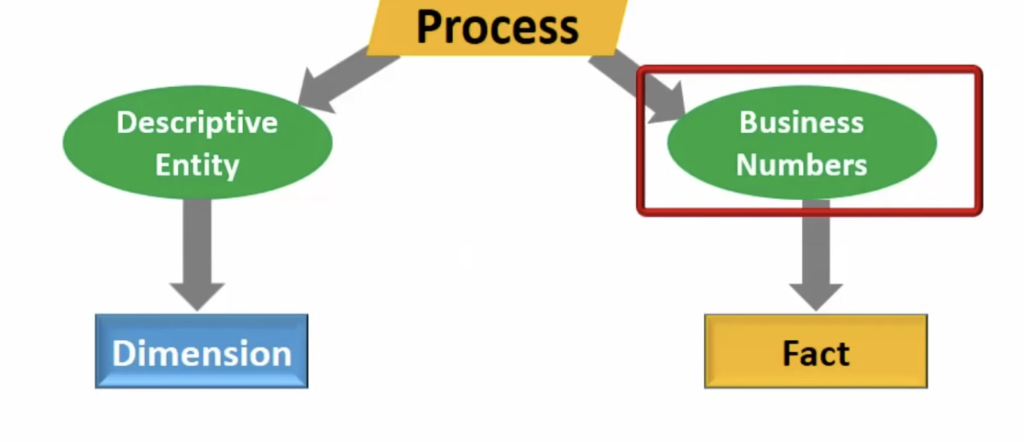
Facts & Dimensions

Slide 16
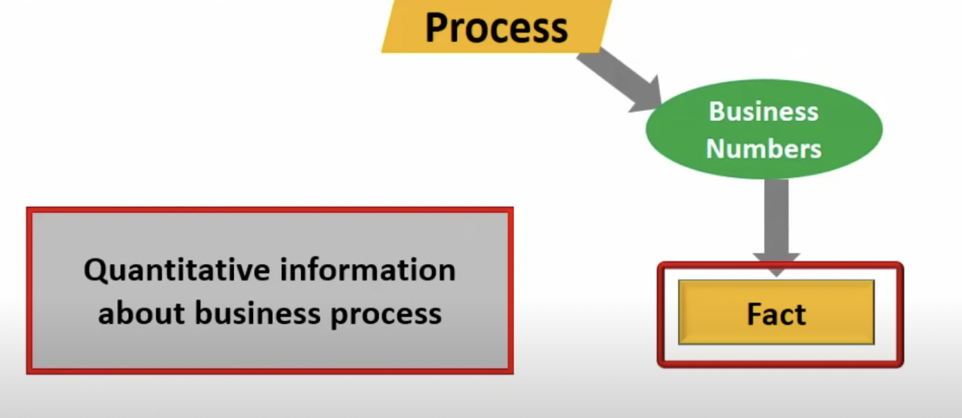
Facts

Slide 17
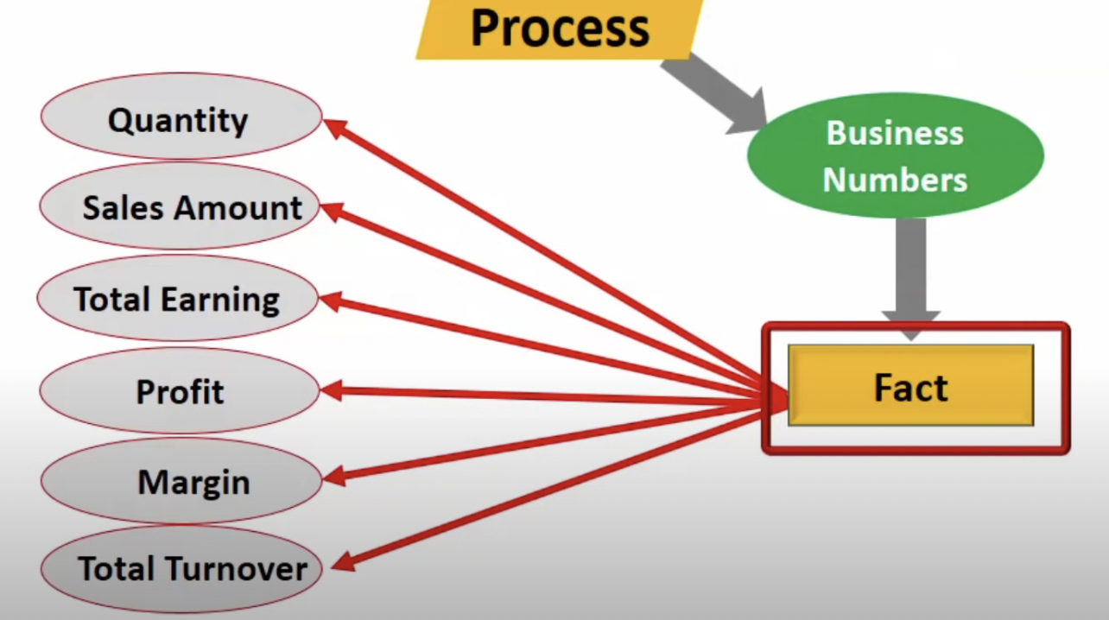
Facts

Slide 18
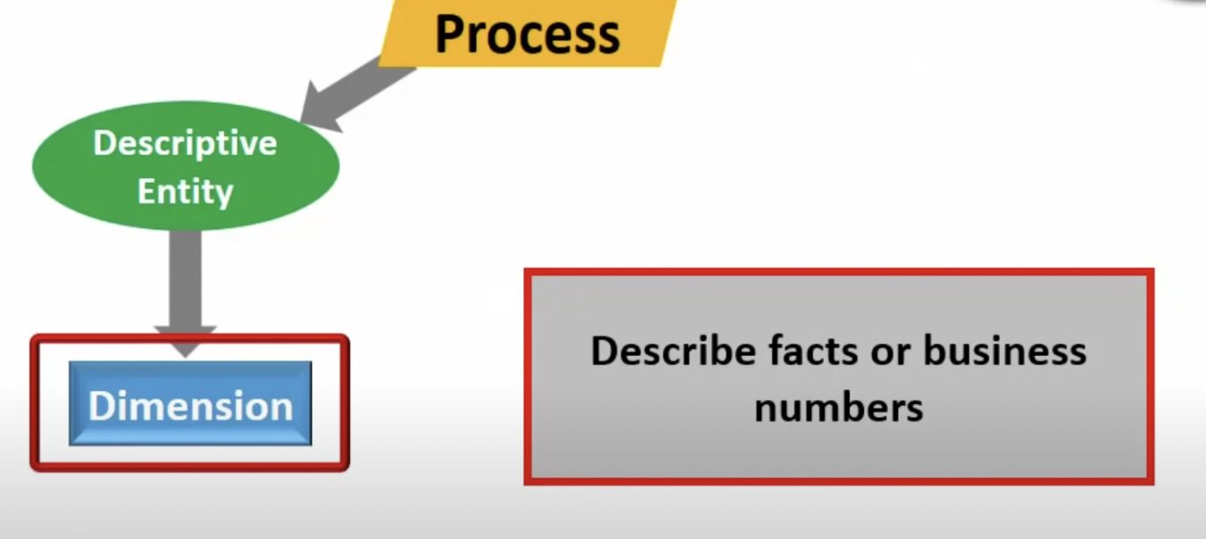
Dimensions

Slide 19
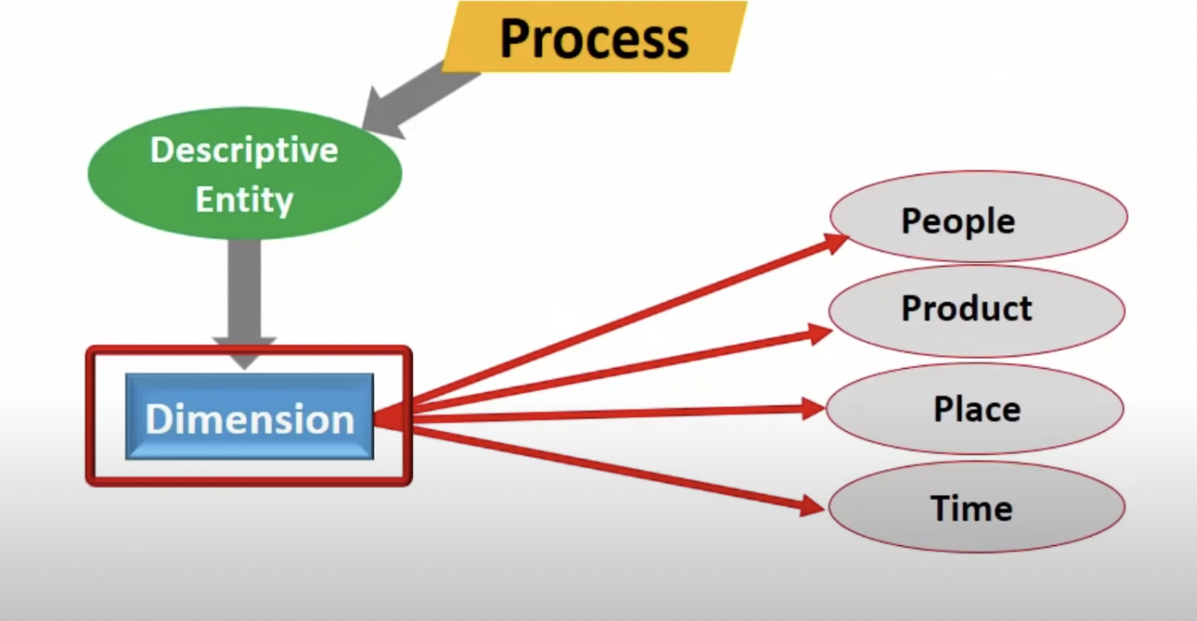
Dimensions

Slide 20
Types of Dimensions in Data Warehouse
Slowly Changing Dimension
Conformed Dimension
Degenerate Dimension
Junk Dimension
Role-playing Dimension

Slide 21
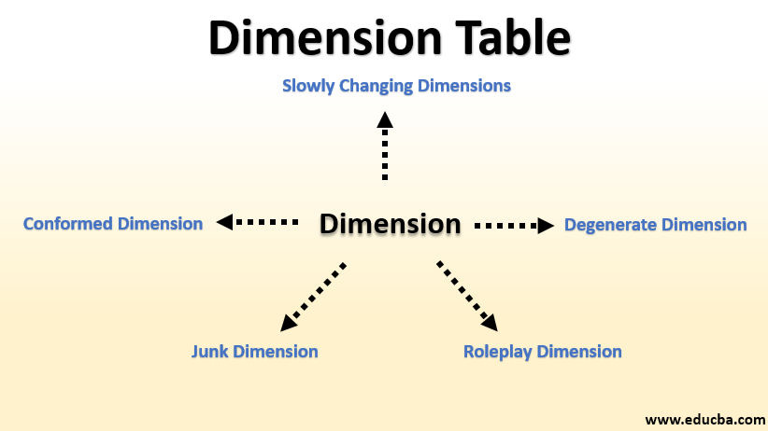

Slide 22
Slowly Changing Dimension
These are the dimension tables that change slowly over time.
There are majorly 3 types of Slowly Changing Dimension tables.
SCD Type 1
SCD Type 2
SCD Type 3

Slide 23
SCD Type 1
In this, no history is stored. If we take Address Dimension as an example then in that we do not store any address history of an individual.
The dimension table consists of only the latest address of the individual.
This approach is easy to design and saves storage!

Slide 24
SCD Type 2
This is the most commonly used type out of all these. In this approach complete history is maintained along with dates to identify from when to when the record is valid.
They are usually called start_date and end_date. If the end date is empty then that means that is the active record!
In Address example, if John moves John moves from New York to Boston then Address Dimension would store from when to when John lived in New York and from when he started living in Boston.
This approach takes lots of storage.

Slide 25
SCD Type 3
In this, only a limited history is stored.
Let's say a business wants to keep only the current address and previous address of the individuals and they do not care to store all of the previous addresses.

Slide 26
Conformed Dimension
A dimension that can be used by multiple facts and has the same meaning across the model is called a Conformed Dimension.
For example, if we have a dimension for a list of places. This can be used across multiple fact tables.

Slide 27
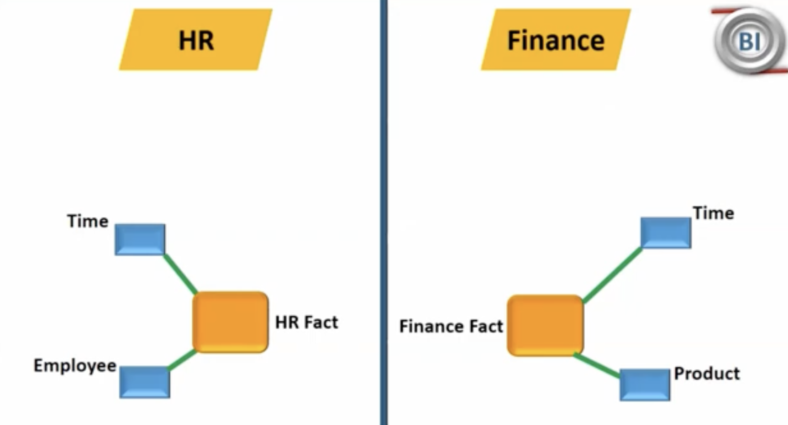
Conformed Dimension Example

Slide 28
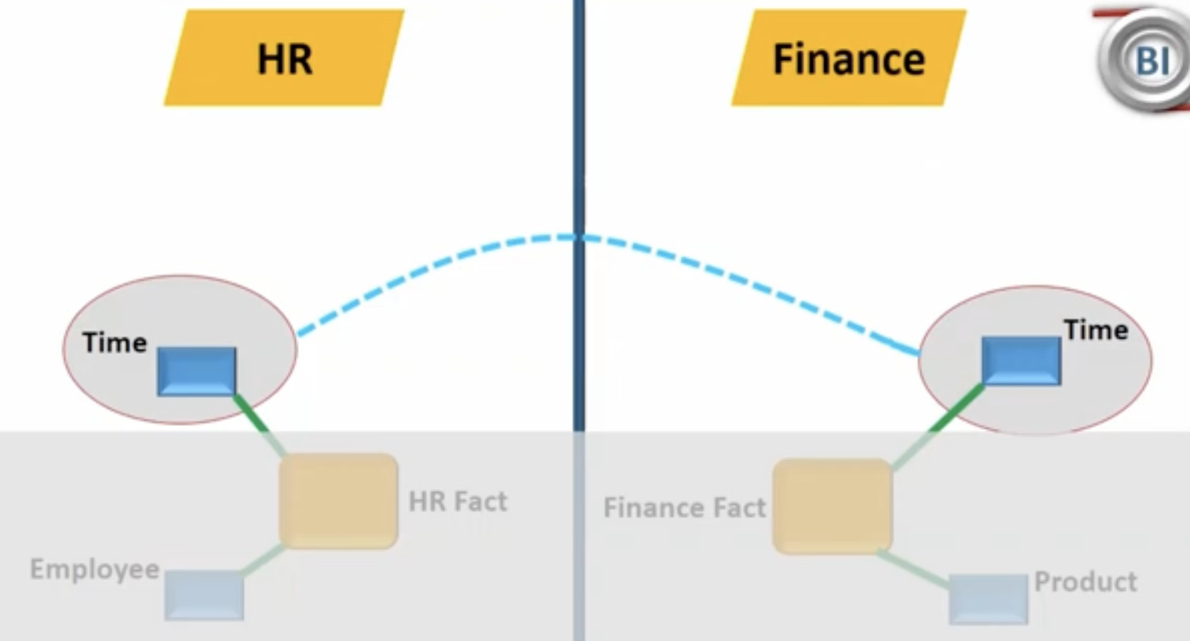
Conformed Dimension Example

Slide 29
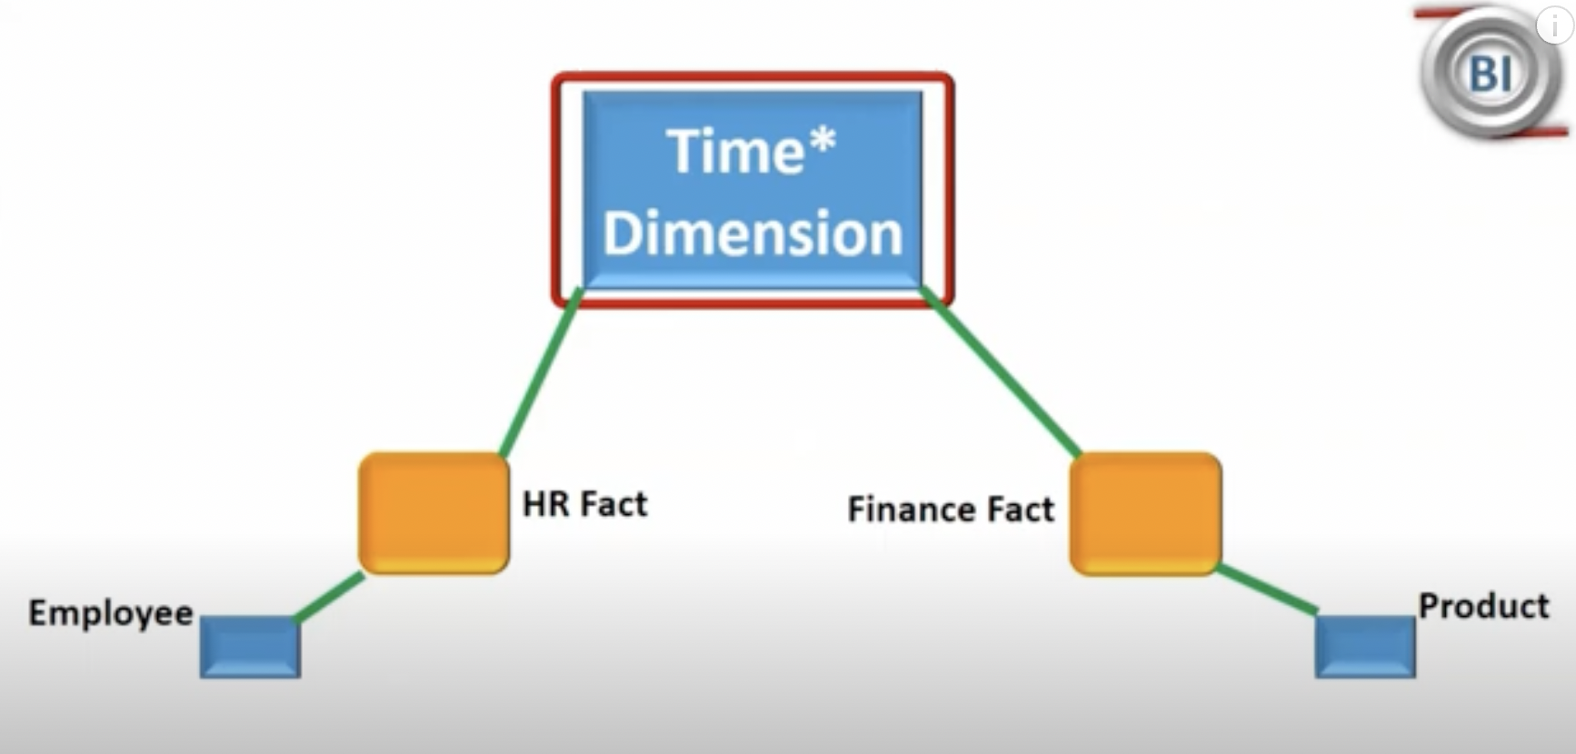
Conformed Dimension Example

Slide 30
Junk Dimension
A junk dimension is the combination of several row-level cardinality flags and attributes into a single dimension table rather than modeling them as a separate dimension table.
Cardinality:
it’s the number of distinct values in a table column relative to the number of rows in the table. Repeated values in the column don’t count.

Slide 31
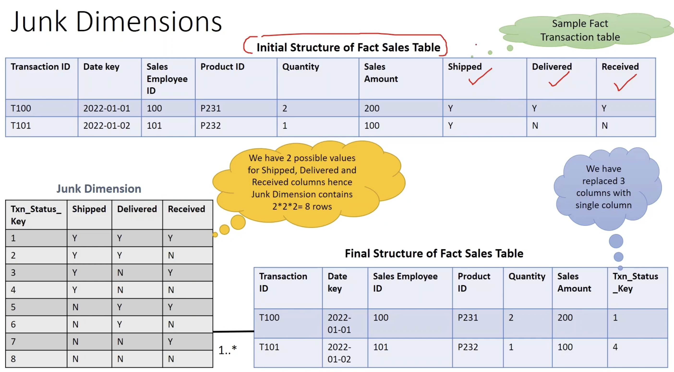

Slide 32
Degenerate Dimension
A Degenerate Dimension is a key, such as a transaction number, invoice number, ticket number, or bill-of-lading number, that has no attributes and hence does not join to an actual dimension table.

Slide 33
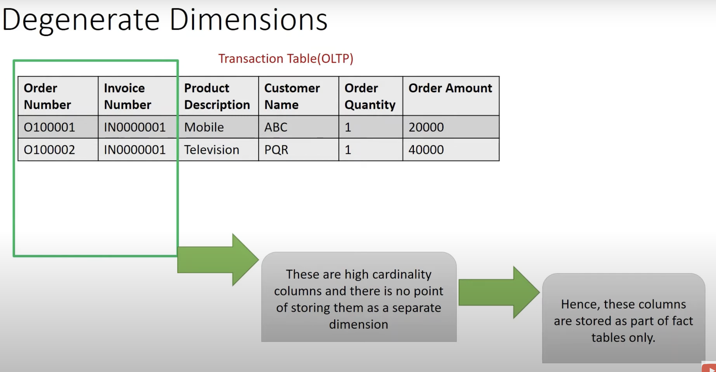

Slide 34
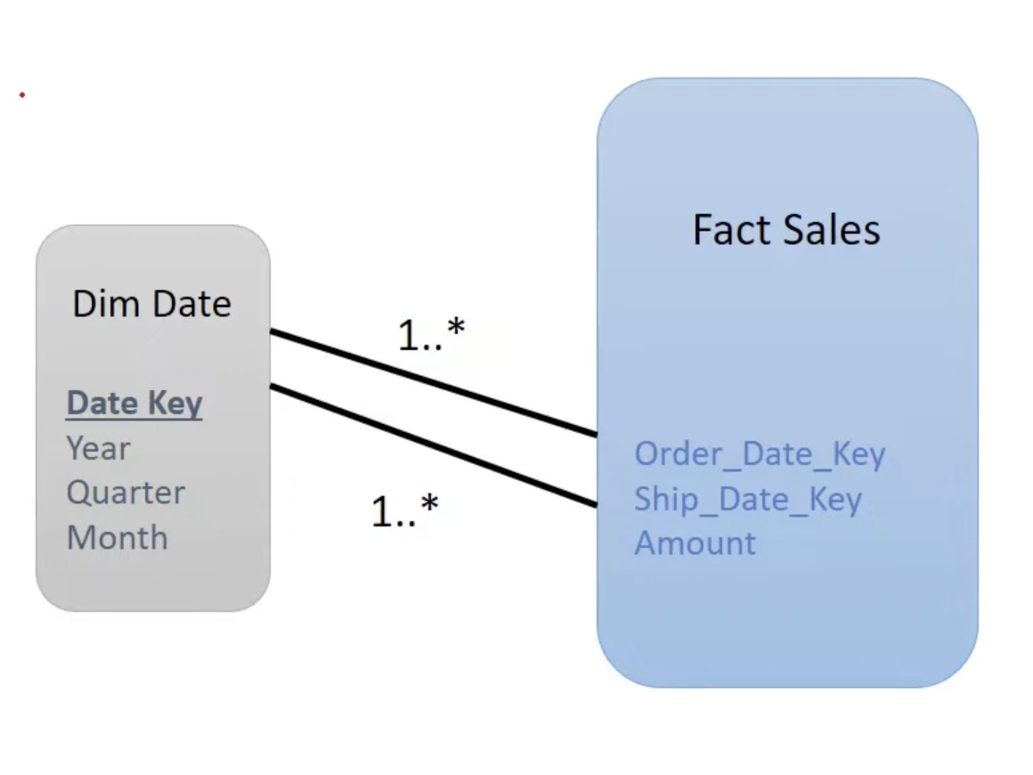
Role-playing Dimension
A single physical dimension can be referenced multiple times in a fact table, with each reference linking to a logically distinct role for the dimension.

Slide 35
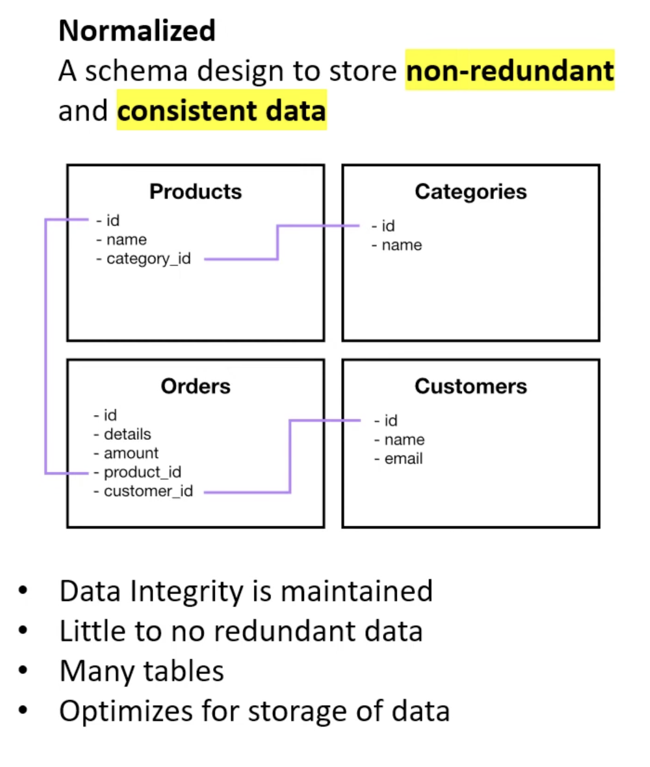
Normalization

Slide 36
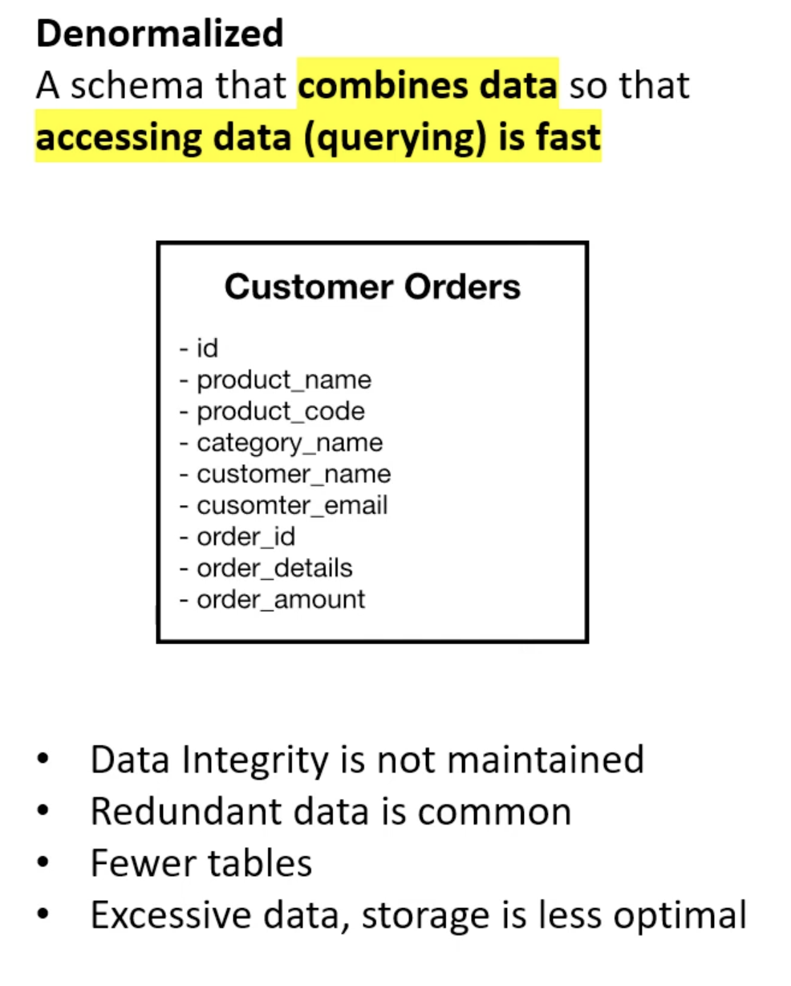
De- Normalization

Slide 37
Data warehouse Schema
Schema is a logical description of the entire database. It includes the name and description of records of all record types including all associated data-items and aggregates.
Star Schema
Snowflake Schema
Fact constellation Schema

Slide 38
Star Schema
Each dimension in a star schema is represented with only one-dimension table.
This dimension table contains the set of attributes.
The following diagram shows the sales data of a company with respect to the four dimensions, namely time, item, branch, and location.
There is a fact table at the center. It contains the keys to each of four dimensions.
The fact table also contains the attributes, namely dollars sold and units sold.

Slide 39
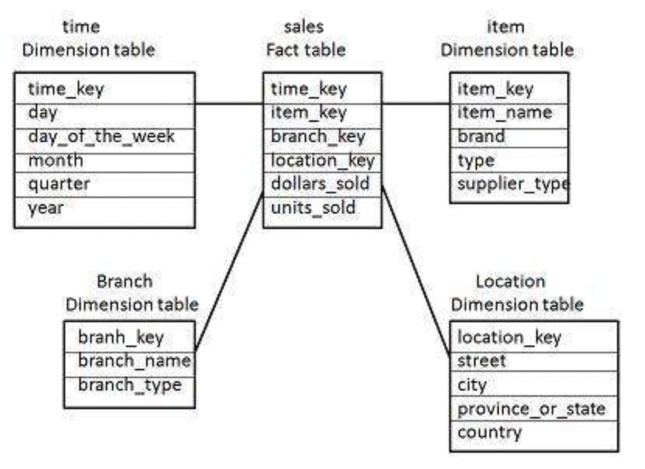
Star Schema

